Slide 1
Naive Bayes Algorithm
Insert Date
Notes:
This is an introductory application of the Naive Bayes algorithm to the spam classification problem.

Slide 2

A Little Background: Classification
Broad class of problems
One type of classifier that can be built is a sentiment analyzer
Determines if the sentiment is positive or negative
Types of classification: binary, multi-class, multi-label
Similar to how trash can be organized into different bins in the example above, classifiers can separate text into different categories
Notes:
Classifiers are the heart of machine intelligence
Many language processing tasks are tasks of classification/categorization
Usually, in language, text categorization is applied, in which the text is classified in terms of criteria (labels)
One type of classifier that can be built is a sentiment analyzer
Determines if the sentiment is positive or negative
Positive: great, richly, awesome
Negative: pathetic, awful, ridiculously
Other ways to classify texts
Spam detection: assign piece of text to one of two categories: spam or not spam
Authorship attribution: classify text by author attributes such as gender, age, and native language
Text category: determine and classify texts by subject
Most classification is done by supervised machine learning due to the unreliability and inconsistency of human classification (i.e. no set borders)

Slide 3
Naive Bayes

Slide 4
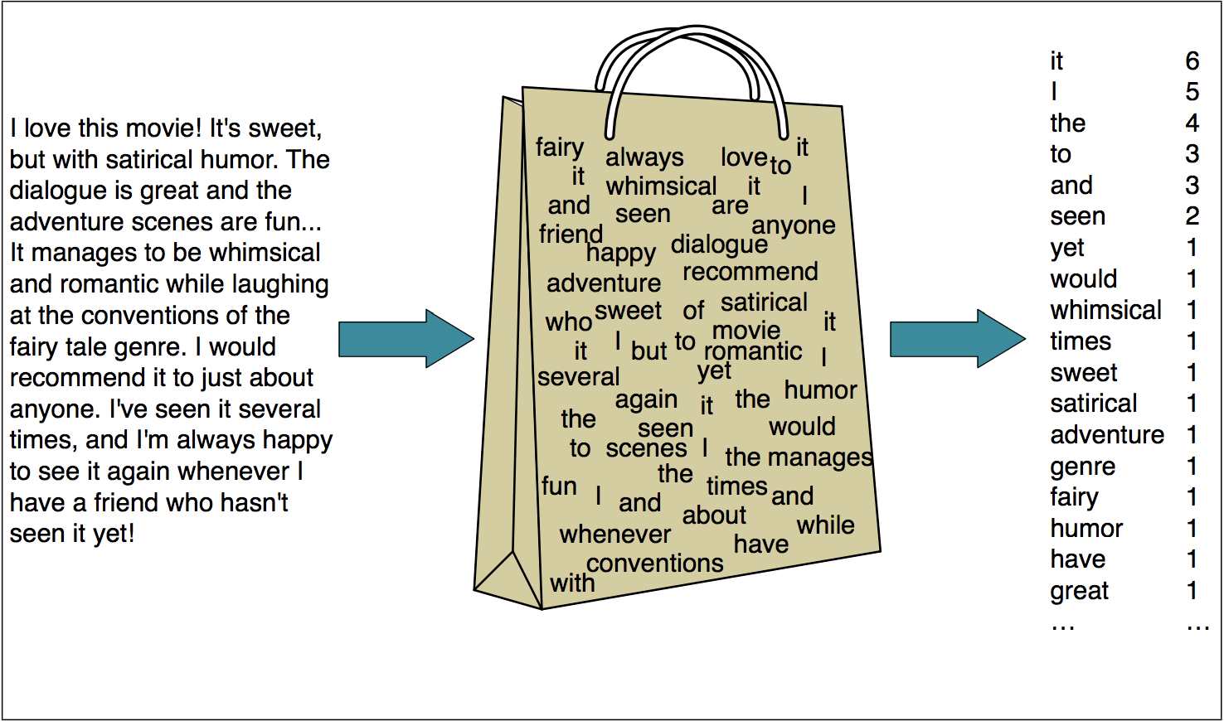
Naive Bayes Classification
Notes:
Source for Image: http://web.stanford.edu/~jurafsky/slp3/6.pdf
Naive Bayes treats a specific passage input as a “bag-of-words”, where only the words matter (the order of the words does not). The word count of each word of the passage is then returned by the algorithm.

Slide 5

Characteristics of Naive Bayes Algorithm
Generative model, unlike SVM
Tries to model the different classes and then match unseen data to the model, rather than take the data as a whole and learn the boundary directly
It is a probabilistic classifier, which means that it will return the class that is most likely suited for that particular input
This means in certain cases, the algorithm results may not be accurate
Notes:
It is a generative classifier: returns classification based on single file data, does not learn/look at trends among different inputs
It is a probabilistic classifier, which means that it will return the class that most likely suited for that particular input which means that it may not be accurate
Ties in with the generative point: only relies on single piece of data and looks at it to see which class (bin) it belongs to

Slide 6
Case Study: Spam Filter
Recall: TF-IDF vectorization
Each document is represented by a vector of TF-IDF scores
These scores can be thought of as features
Take all the spam documents and calculate the average and standard deviation of features to “model” the spam class; do the same with ham
Task: for a given document, calculate the probability that it belongs to spam given that it has a specific set of TF-IDF features
Notes:
Explanation for the formula at the bottom: the predicted class (c-hat) is equal to the class (among the possible set of classes) for which P(c|d) is the greatest. P(c|d) = probability that a piece of text is of class c given its TFIDF features d

Slide 7
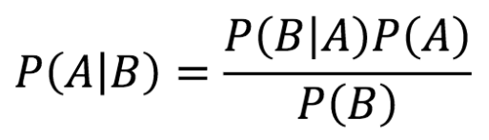
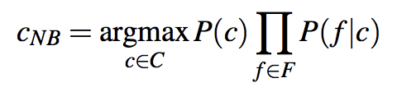
Recall: Bayes’ Rule
Notes:
P(c|d) = P(d|c)*P(c)/P(d)
P(d) is the same for all documents across all classes, so cancel out
P(c) is the proportion of the training data that belongs to class c (nice factor to have for balancing, so if you don’t have enough of 1, don’t trust the decision as much)
P(f|c) is the probability that you would have a given set of features given that it belongs to class C
Take each feature and calculate its probability, multiply them all

Slide 8
General Procedure
For each feature, calculate the average and standard deviation score for the class
Assume a normal distribution
normalcdf(-1E99, test score, mean, stdev) = probability
Example: 1. She likes pizza. 2. He likes pasta. 3. Pizza is awesome.
Words in corpus: <she, likes, pizza, he, pasta, is, awesome>
Vectorizations: 1. <.3662, .1352, .1352, 0, 0, 0, 0> 2. <0, .1352, 0, .3662, .3662, 0, 0> 3. <0, 0, .1352, 0, 0, .3662, .3662>
Average Scores for Pizza: <.1831, .0676, .1352, 0, 0, .1831, .1831> Standard Deviations for Pizza: <.259, .096, 0, 0, 0, .259, .259> Probability Example: 1. <.76, .76, 1, 1, 1, .24, .24> P(c)*P(f|c) = ⅔ * .76*.76*.24*.24 = .022
Notes:
Example: 1 and 3 are pizza sentences
2 is a pasta sentence

Slide 9
Demo: Spam Classification Problem
Code: https://repl.it/@enscma2/NaiveBayesClassificationDemo
Fork Repl, go to Shell, run pip install scikit-learn
Data: https://www.kaggle.com/uciml/sms-spam-collection-dataset
Notes:
Same classification task as the Support Vector Machine lecture, just switches out LinearSVC for GaussianNB, which is the scikit-learn Naive Bayes classifier function - so just step through the code like you did for the SVM version of this classifier, and note the changes

